Slide 1
Dynamic Storage Allocation Problem
Variable number of partitions, variable size
Each program allocated exactly as much memory as it requires
Eventually holes appear in main memory between the partitions
  We call this External Fragmentation
Periodically, use compaction to shift programs so they are contiguous
  Merging free memory into one block

Slide 2
Dynamic Storage-Allocation
OS keeps a table indicating which parts of memory are available and which are occupied.
  Initially all memory is available for user processes (set of holes contains 1 large hole)
  When processes arrive and need memory, search for a hole big enough
  If a hole is too large, split in 2 (1 part for process, 1 part returned to set of holes)
  If new hole is adjacent to other holes, may be merged to form 1 larger hole

Slide 3
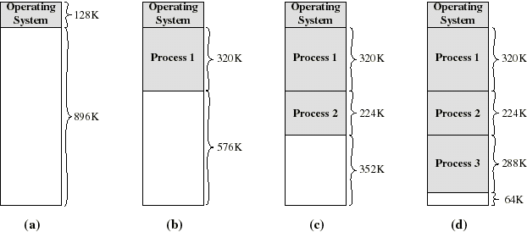
Dynamic Partitioning: an example
(a-d) P1, P2, P3 are allocated memory.
P4 needs 128k: but after loading first 3, there is only a single hole of 64k, so P4 must wait.
Eventually all 3 processes are blocked
OS swaps out P2 (closest fit) and brings in P4 (128k)

Slide 4
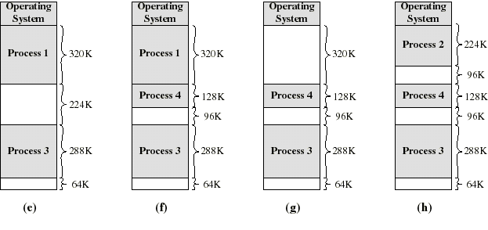
Dynamic Partitioning: an example
(e,f) remove process 2, load process 4 leaves a hole of 224-128=96K (external fragmentation)
(g,h) Process 1 suspended to bring in process 2 again, creating another hole of 320-224=96K...
Left with 3 small and probably useless holes. Compaction would produce a single hole of 96+96+64=256K

Slide 5
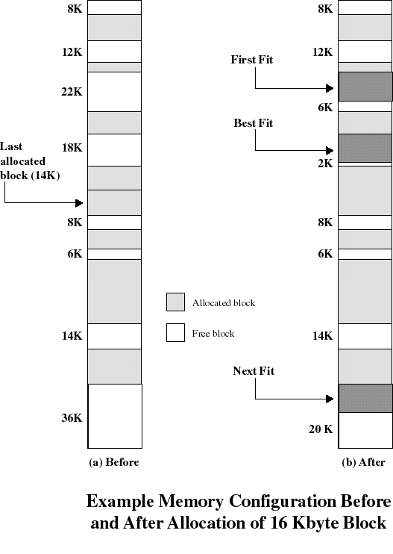
Placement Algorithm
Decide which free block to allocate to a program
Possible algorithms:
  Best-fit: choose smallest hole that fits
    creates small holes!
  First-fit: choose first hole from beginning that fits
    generally superior
    Next-fit: variation: first hole from last placement that fits
  Worst-fit: use largest hole
    leaves largest leftover
(also worst fit)

Slide 6
Advantages/Disadvantages of Placement Algorithms
First fit and best fit are generally better than worst fit
  Both are better in terms of storage
  First fit is faster than both best and worst fit
All suffer from external fragmentation
  Exists enough total memory exists to satisfy a request, but it is not contiguous (lots of small holes)
  Worst case can have small block of memory between every 2 processes

Slide 7
Compaction
External fragmentation can be resolved through compaction
Shuffles the memory contents to put all free memory together in one block
Compaction algorithm is expensive, but so is not making efficient use of memory, especially with a lot of concurrent processes
Only possible if relocation is dynamic
  Relocation requires moving program and data, changing the base register

Slide 8
Relocation
Because of swapping and compaction, a process may occupy different main memory locations during its lifetime
So we usually use special hardware to perform address mapping to allow us to support relocation at run time
We will distinguish between logical address and physical address:

Slide 9
Address Terminology
Physical address: a physical location in main memory, from the point of view of the memory system.
Logical (virtual) address: an address as used in a program, an address as generated by the CPU when executing that program
  so an address from point of view of the CPU

Slide 10
Memory Management Unit (MMU)
memory
relocation
register
(base reg)
14000
MMU
CPU
logical address
physical address
123
14123
+
  32 bit address register = 4 Gigabytes of virtual memory
  Actually only 64 (128..) Megabytes of physical memory
  Need to map down from a large virtual address space to a smaller physical memory space

Slide 11
Paging
Fragmentation is a significant problem with all these memory management schemes
Let’s organize physical address spaced (main memory) into equal (small) sized chunks called frames.
And divide logical (virtual) address space into chunks of the same size called pages
The pages of a program can thus be mapped to the available frames in main memory, not necessarily contiguous
Result: a process can be scattered all over the physical memory.

Slide 12
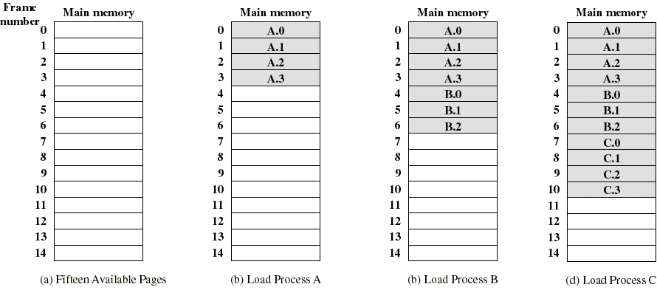
Example of Program Loading by Page
..now suppose that process B is swapped out

Slide 13
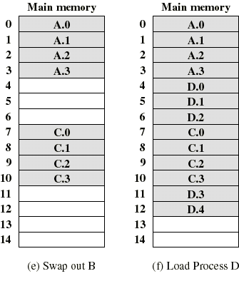
Process Loading by Page
Now process D consisting of 5 pages is loaded
Program D does not occupy a contiguous section of memory
No external fragmentation!
Internal fragmentation limited to part of the last page of each program (average 1/2 page/program).

Slide 14
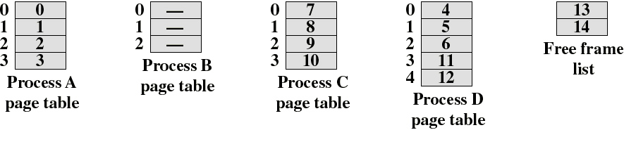
Page Tables
We keep a page table for each process
A page table entry is the frame number where the
corresponding page is physically located
Page table is indexed by page number to obtain the
frame number
We also need a Free frame list to keep track of
unused frames

Slide 15
Logical Address in Paging
Within each program, each logical address consists of a page number and an offset within the page
A Memory Management Unit (MMU) is put between the CPU address bus and physical memory bus
A MMU register holds the starting physical address of the page table of the process currently running
Presented with a logical address (page number, offset) the MMU accesses the page table to obtain the physical address (frame number, offset)

